Slide 1

Team7
Anime character
detection
108020022 周昱宏
108062107 鄭博薪
108070038 簡志宇
108071003 李彥璋

Slide 2



Goal

Slide 3







Dataset
Something different from our proposal...

Slide 4





Get dataset
Download videos
Take some screenshots
Filter by machine
Filter manually

Slide 5
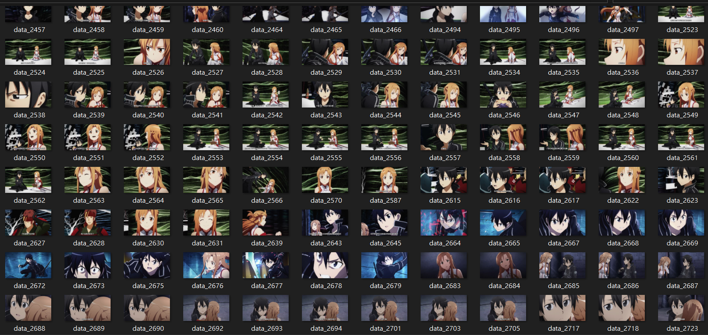
Dataset sample

Slide 6
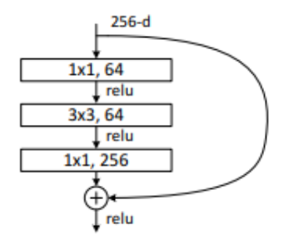
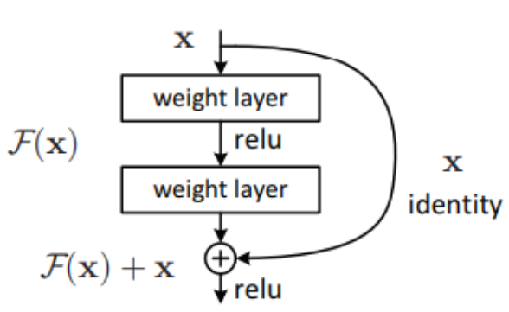
Model
ResNet
Identity Mapping
input x，output H(x) = x
Residual Mapping
H(x) => F(x) := H(x) – x
Shortcut Connections
input x -> non-linear trans -> output F(x)
Bottleneck
1x1 conv

Slide 7
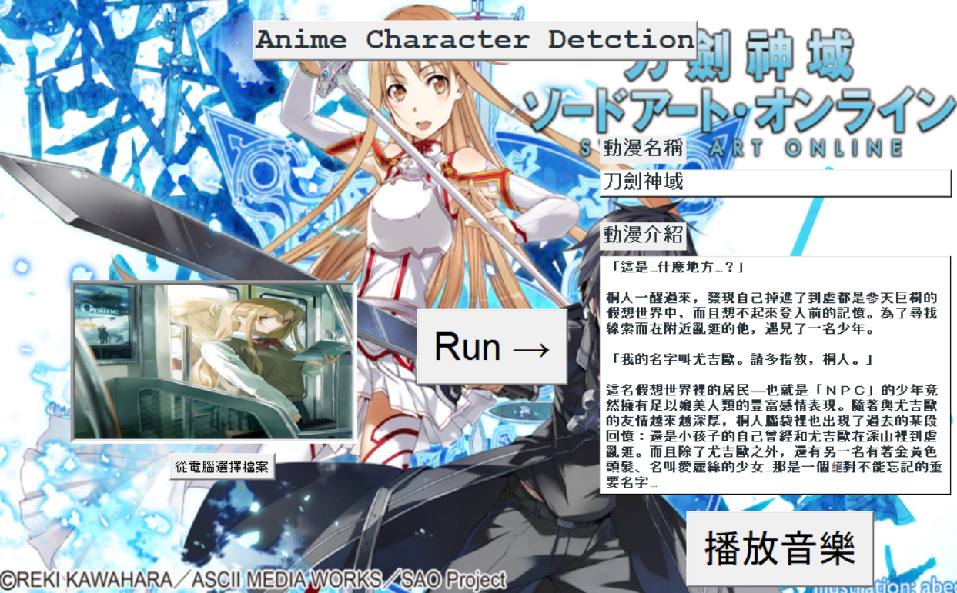
result

Slide 8

future
Add more dataset!
Raise the performance!
Improve UI interface!

Slide 9
Thanks!

